Slide 1
Introduction to machine learning/AI
Mahir academy

Slide 2

Material
All material available on GitHub
this presentation
conda environments
Jupyter notebooks
https://github.com/piroxi/machine-learning

Slide 3

Introduction
Machine learning is making great strides
Large, good data sets
Compute power
Progress in algorithms
Many interesting applications
commercial
scientific
Links with artificial intelligence
However, AI ≠ machine learning

Slide 4
Machine learning tasks
Supervised learning
regression: predict numerical values
classification: predict categorical values, i.e., labels
Unsupervised learning
clustering: group data according to "distance"
association: find frequent co-occurrences
link prediction: discover relationships in data
data reduction: project features to fewer features
Reinforcement learning

Slide 5
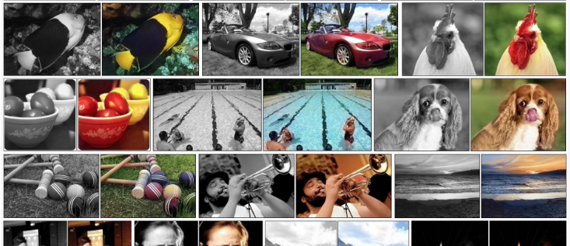
Regression
Colorize B&W images automatically
https://tinyclouds.org/colorize/

Slide 6
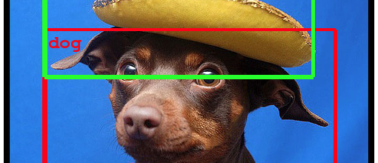
Classification
Object recognition
https://ai.googleblog.com/2014/09/building-deeper-understanding-of-images.html

Slide 7
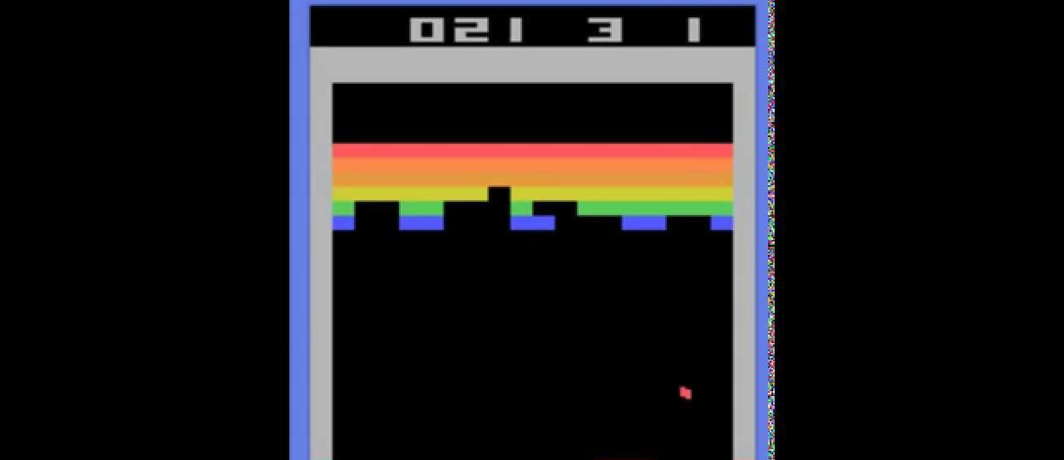
Reinforcement learning
Learning to play Break Out
https://www.youtube.com/watch?v=V1eYniJ0Rnk

Slide 8
Clustering
Crime prediction using k-means clustering
http://www.grdjournals.com/uploads/article/GRDJE/V02/I05/0176/GRDJEV02I050176.pdf

Slide 9
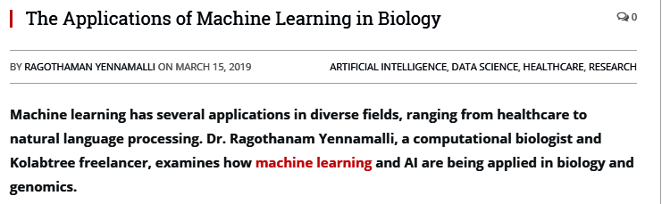
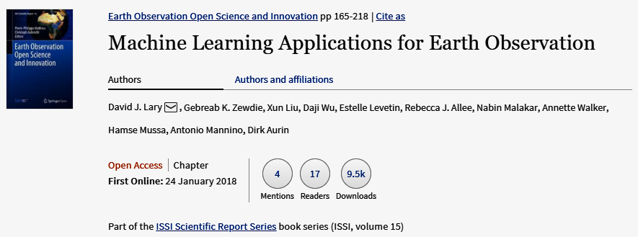
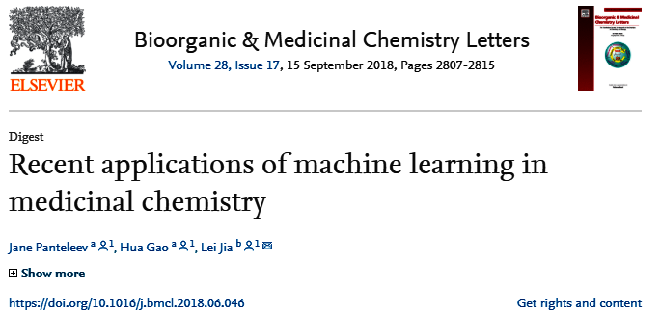
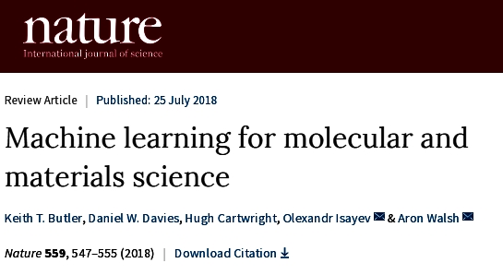
Applications in science

Slide 10
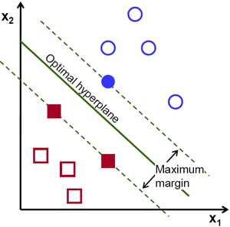
Machine learning algorithms
Regression: Ridge regression, Support Vector Machines, Random Forest, Multilayer Neural Networks, Deep Neural Networks, ...
Classification: Naive Base, , Support Vector Machines, Random Forest, Multilayer Neural Networks, Deep Neural Networks, ...
Clustering: k-Means, Hierarchical Clustering, ...

Slide 11

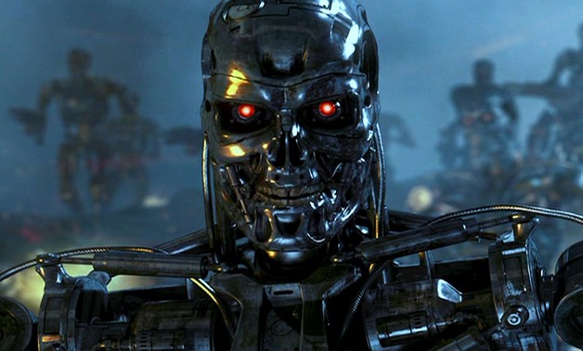
Issues
Many machine learning/AI projects fail (Gartner claims 85 %)
Ethics, e.g., Amazon has/had sub-par employees fired by an AI automatically

Slide 12

Reasons for failure
Asking the wrong question
Trying to solve the wrong problem
Not having enough data
Not having the right data
Having too much data
Hiring the wrong people
Using the wrong tools
Not having the right model
Not having the right yardstick
Notes:
https://www.kdnuggets.com/2018/07/why-machine-learning-project-fail.html

Slide 13
Frameworks
Programming languages
Python
R
C++
...
Many libraries
scikit-learn
PyTorch
TensorFlow
Keras
…
Fast-evolving ecosystem!
classic machine learning
deep learning frameworks

Slide 14

scikit-learn
Nice end-to-end framework
data exploration (+ pandas + holoviews)
data preprocessing (+ pandas)
cleaning/missing values
normalization
training
testing
application
"Classic" machine learning only
https://scikit-learn.org/stable/

Slide 15


Keras
High-level framework for deep learning
TensorFlow backend
Layer types
dense
convolutional
pooling
embedding
recurrent
activation
…
https://keras.io/

Slide 16

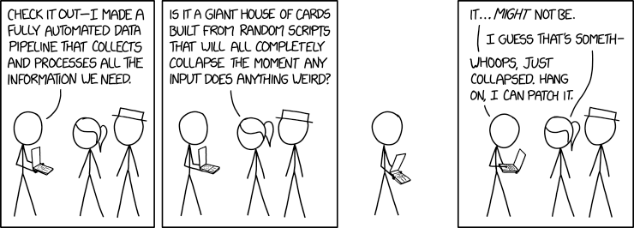
Data pipelines
Data ingestion
CSV/JSON/XML/H5 files, RDBMS, NoSQL, HTTP,...
Data cleaning
outliers/invalid values? → filter
missing values? → impute
Data transformation
scaling/normalization
Must be done systematically

Slide 17
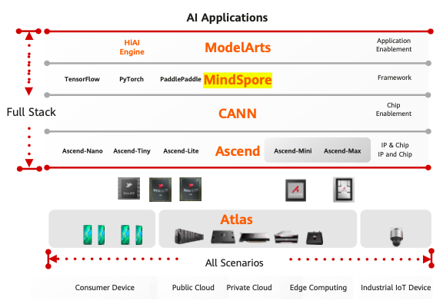
Huawei's Full-Stack, All-Scenario AI Portfolio
Application enablement: provides end-to- end services (ModelArts), layered APIs, and pre-integrated solutions.
MindSpore: supports the unified training and inference framework that is independent of the device, edge, and cloud.
CANN: a chip operator library and highly automated operator development tool.
Ascend: provides a series of NPU IPs and chips based on a unified, scalable architecture.
Atlas: enables an all-scenario AI infrastructure solution that is oriented to the device, edge, and cloud based on the Ascend series AI processors and various product forms.

Slide 18
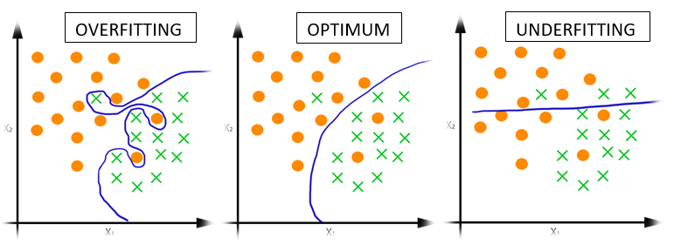
Supervised learning: methodology
Select model, e.g., random forest, (deep) neural network, ...
Train model, i.e., determine parameters
Data: input + output
training data → determine model parameters
validation data → yardstick to avoid overfitting
Test model
Data: input + output
testing data → final scoring of the model
Production
Data: input → predict output
Experiment with underfitting and overfitting:
010_underfitting_overfitting.ipynb

Slide 19
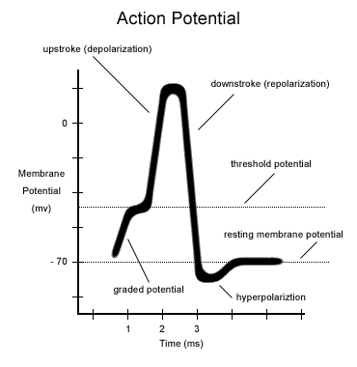
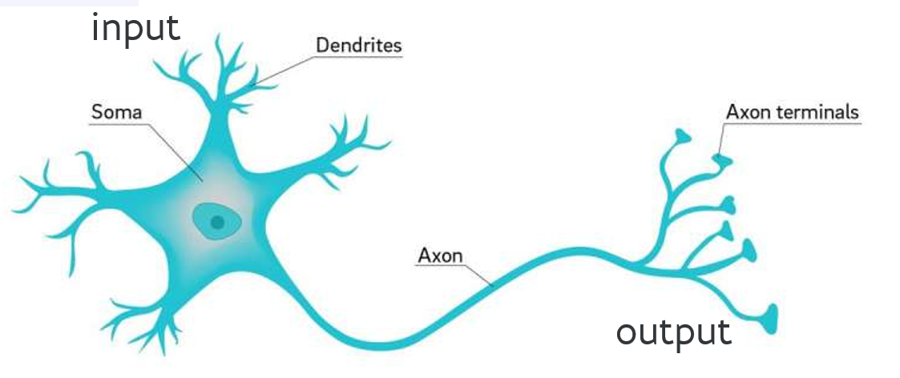
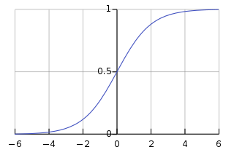











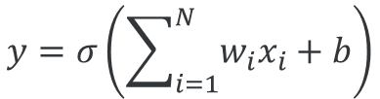


From neurons to ANNs
inspiration
$$x_{1}$$
$$w_{1}$$
$$y=σ\left(\sum_{i=1}^{N}{w_{i}x_{i}+b}\right)$$
$$σ\left(x\right)$$
$$x_{2}$$
$$w_{2}$$
$$y$$
activation function
$$w_{3}$$
$$x_{3}$$
$$b$$
$$x$$
...
$$+1$$
$$w_{N}$$
$$x_{N}$$

Slide 20
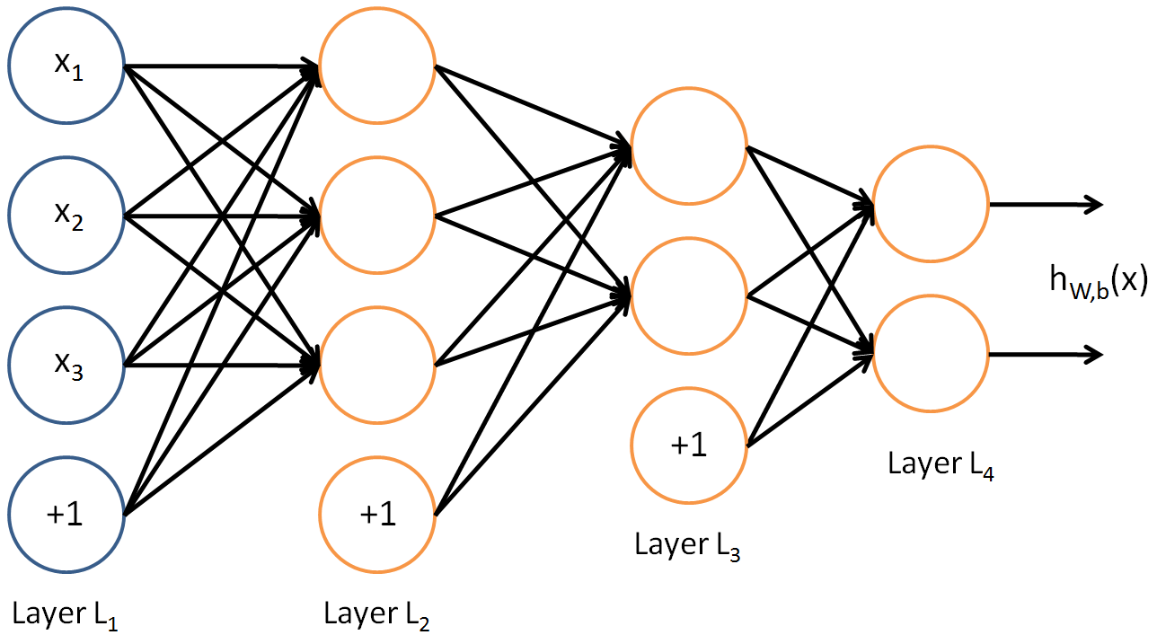
Multilayer network
How to determine weights?

Slide 21
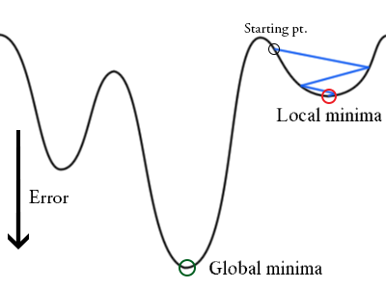
Training: backpropagation
Initialize weights "randomly"
For all training epochs
for all input-output in training set
using input, compute output (forward)
compare computed output with training output
adapt weights (backward) to improve output
if accuracy is good enough, stop

Slide 22
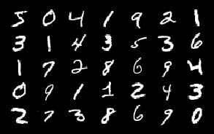
Task: handwritten digit recognition
Input data
grayscale image
Output data
digit 0, 1, ..., 9
Training examples
Test examples
Explore the data: 020_mnist_data_exploration.ipynb

Slide 23

First approach
Data preprocessing
Input data as 1D array
output data as array with one-hot encoding
Model: multilayer perceptron
758 inputs
dense hidden layer with 512 units
ReLU activation function
dense layer with 512 units
ReLU activation function
dense layer with 10 units
SoftMax activation function
array([ 0.0, 0.0,..., 0.951, 0.533,..., 0.0, 0.0], dtype=float32)
5
array([ 0, 0, 0, 0, 0, 1, 0, 0, 0, 0], dtype=uint8)
Activation functions: 030_activation_functions.ipynb
Multilayer perceptron: 040_mnist_mlp.ipynb

Slide 24
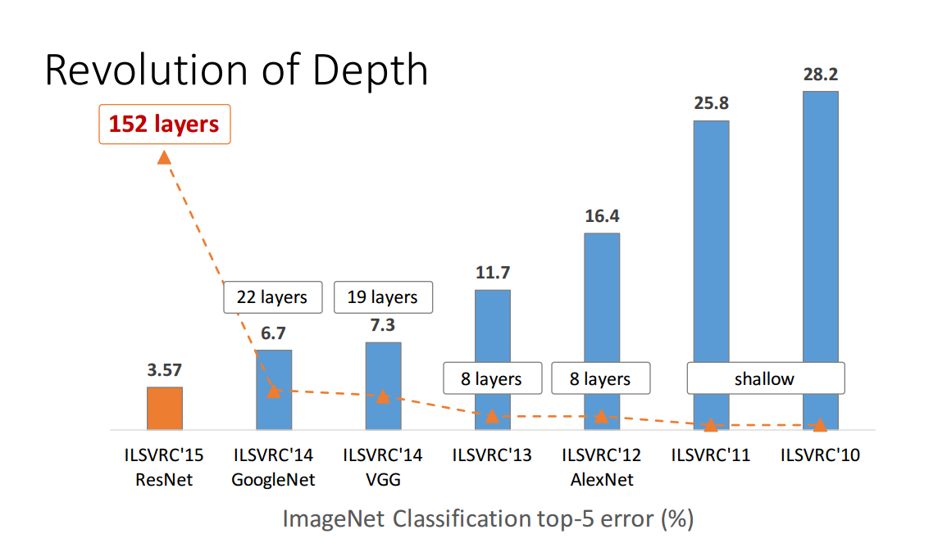
Deep neural networks
Many layers
Features are learned, not given
Low-level features combined into high-level features
Special types of layers
convolutional
drop-out
recurrent
...

Slide 25
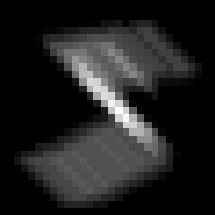
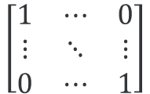
Convolutional neural networks
$$\left[\begin{matrix}1 & ⋯ & 0 \\ ⋮ & ⋱ & ⋮ \\ 0 & ⋯ & 1\end{matrix}\right]$$
⊗

Slide 26

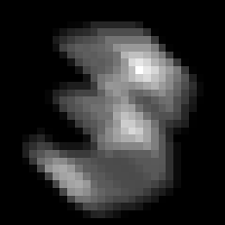


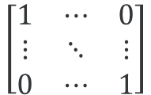
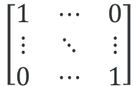
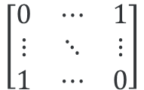
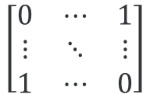
Convolution examples
$$\left[\begin{matrix}1 & ⋯ & 0 \\ ⋮ & ⋱ & ⋮ \\ 0 & ⋯ & 1\end{matrix}\right]$$
$$\left[\begin{matrix}1 & ⋯ & 0 \\ ⋮ & ⋱ & ⋮ \\ 0 & ⋯ & 1\end{matrix}\right]$$
$$\left[\begin{matrix}0 & ⋯ & 1 \\ ⋮ & ⋱ & ⋮ \\ 1 & ⋯ & 0\end{matrix}\right]$$
$$\left[\begin{matrix}0 & ⋯ & 1 \\ ⋮ & ⋱ & ⋮ \\ 1 & ⋯ & 0\end{matrix}\right]$$
Convolution: 050_convolution.ipynb

Slide 27
Second approach
Data preprocessing
Input data as 2D array
output data as array with one-hot encoding
Model: convolutional neural network (CNN)
28 × 28 inputs
CNN layer with 32 filters 3 × 3
ReLU activation function
flatten layer
dense layer with 10 units
SoftMax activation function
array([[ 0.0, 0.0,..., 0.951, 0.533,..., 0.0, 0.0]], dtype=float32)
5
array([ 0, 0, 0, 0, 0, 1, 0, 0, 0, 0], dtype=uint8)
Convolutional neural network: 060_mnist_cnn.ipynb

Slide 28


Task: sentiment classification
Input data
movie review (English)
Output data
Training examples
Test examples
<start> this film was just brilliant casting location
scenery story direction everyone's really suited the part
they played and you could just imagine being there Robert
Redford's is an amazing actor and now the same being director
Norman's father came from the same Scottish island as myself
so I loved the fact there was a real connection with this
film the witty remarks throughout the film were great it was
just brilliant so much that I bought the film as soon as it
…
/
Explore the data: 070_imdb_data_exploration.ipynb

Slide 29
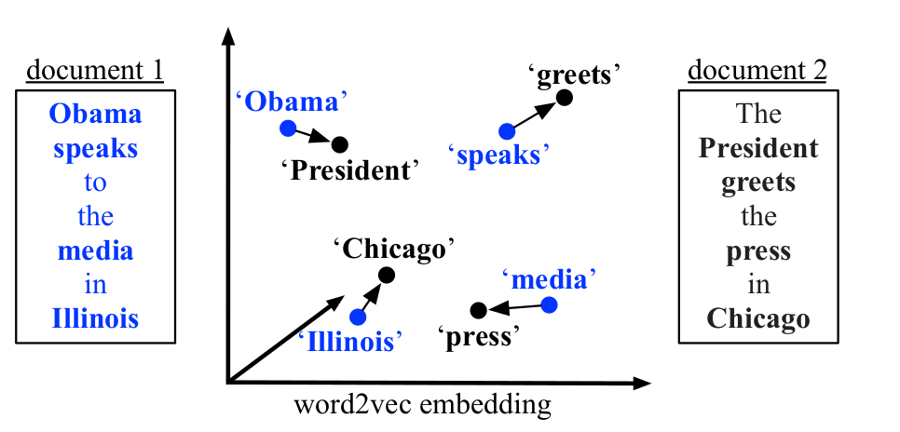
Word Embedding
Represent words as one-hot vectors length = vocabulary size
Word embeddings
dense vector
vector distance ≈ semantic distance
Training
use context
discover relations with surrounding words
Issues:
unwieldy
no semantics

Slide 30
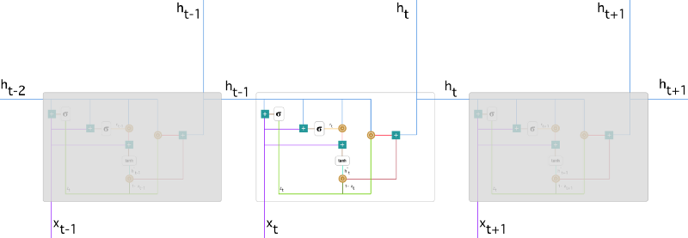
How to remember?
Manage history, network learns
what to remember
what to forget
Long-term correlations!
Use, e.g.,
LSTM (Long Short-Term Memory)
GRU (Gated Recurrent Unit)
Deal with variable length input and/or output

Slide 31
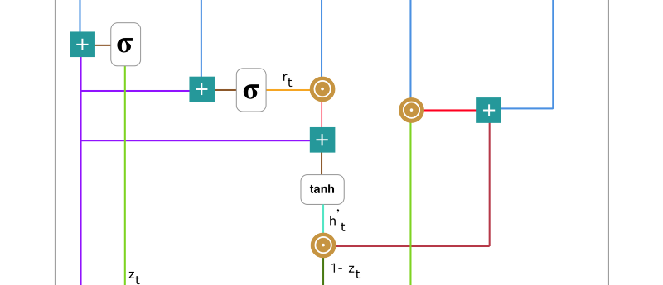




Gated Recurrent Unit (GRU)
Update gate
Reset gate
Current memory content
Final memory/output
$$z_{t}=σ\left(W_{z}x_{t}+U_{z}h_{t−1}\right)$$
$$r_{t}=σ\left(W_{r}x_{t}+U_{r}h_{t−1}\right)$$
$${h′}_{t}=tanh\left(Wx_{t}+r_{t}⊙Uh_{t−1}\right)$$
$h_{t}=z_{t}⊙h_{t−1}+\left(1−z_{t}\right)$ $⊙{h′}_{t}$

Slide 32
Approach
Data preprocessing
Input data as padded array
output data as 0 or 1
Model: recurrent neural network (GRU)
100 inputs
embedding layer, 5,000 words, 64 element representation length
GRU layer, 64 units
dropout layer, rate = 0.5
dense layer, 1 output
sigmoid activation function
Recurrent neural network: 080_imdb_rnn.pynb

Slide 33



Caveat
InspiroBot (http://inspirobot.me/)
"I am an artificial intelligence dedicated to generating unlimited amounts of unique inspirational quotes for endless enrichment of pointless human existence".

